Slide 1

INSIGHT
INTO
NEW TESTING , ADJUSTING, BALANCING & COMMISSIONING (TABC) SPECIFICATION OF AIR CONDITIONING AND MECHANICAL VENTILATION SYSTEM
Mesyuarat Tahunan Jurutera Mekanikal 2016
5-7th September 2016

Slide 2
Contents
Why do we need to improve testing specification?
Insight into new specification.
Conclusion

Slide 3
Why
Higher expectations from clients/user on the building system performance, extensive performance verification is required.
Operational issues arises due to absence or inadequate testing and commissioning procedures.
Scope of testing in current specification need to be revised to address above issues.
Notes:
Few cases e.g noise, humidity and cases where temp is above design but we endorsed them as acceptable.
Latent defects due to design and installation e.g condensation, fungus
Need more comprehensive t&C to verify performance at every stage of construction.
Design commissioning at earlier stage.
Always remained sceptical on performance data

Slide 4
Improved Specification Features
  Overall scope of testing and commissioning
  Carried out in 5 stages i.e Pre-delivery, Delivery, Installation and Functional Performance Test, Post Occupancy Performance Assessment
  Enhance type of inspection and testing
  Comprehensive and objective based test requirements and methods.
  Tools
  Improved measuring tools specification including accuracy and calibration requirement.
  Procedures
  Inclusion of ITP plan submission and implementation.
  New Post Occupancy Performance Assessment.
  New document structure
  More structured and easy to use.

Slide 5
Why do we need Testing, Adjusting, Balancing and Commissioning
To verify that delivered materials are as per approved specification and good physical condition.
To verify that the installation works are carried out in accordance with specification and good engineering practises.
To verify that the performance in terms of functionality, safety, maintainability and operation ability of the installed equipment/systems meet the specified design intent through a series of tests and adjustments.
To ensure that all test result are systematically recorded and verified prior to system commissioning.
1
2
3
4

Slide 6
Testing, Adjusting, Balancing and Commissioning Phases
Pre
Delivery
Delivery
Installation
Functional Performance Test
Post Occupancy Evaluation
Introduced into new specification
Inspection and Testing Plan

Slide 7
INSPECTION AND TESTING PLAN
List out all TABC works required in the specification with specified scope and boundaries.
WHAT ?
WHO?
Responsibility to conduct and verify test shall be clearly stated.
TABC work schedules shall be integrated into main project schedules.
WHEN
HOW
TABC method statements shall consists of TABC procedures, responsibility, necessary tools, measuring equipment and accuracy, consumables and acceptance criteria.

Slide 8
Sample of ITP
Stage | Inspection and Test Name | Scope and Boundaries | Responsibility | Method Statement no | Expected Date
Pre Delivery Inspection | Full load Performance Test (AHRI) | Water cooled chiller (WCH-01) | Manufacturer | MS-ITP-PDI-01 | Jan-17
Incoming Material | Equipment verification and physical Inspection | Water cooled chiller (WCH-01) | Contractor | MS-ITP-PDI-03 | Mar-17
Installation | Chilled water pipe leak test | Riser | Contractor | MS-ITP-PDI-06 | May-17
Functional Performance Test | Chiller Plant Functional Performance Test | Chiller plant i.e chillers, pumps, cooling tower | Contractor | MS-ITP-PDI-09 | Feb-18
Functional Performance Test | AHU Performance Test | AHU and FCU | Contractor | MS-ITP-PDI-10 | Feb-18

Slide 9
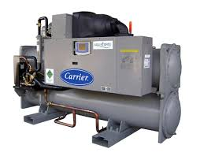
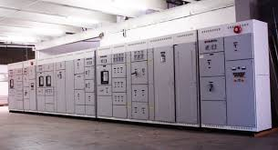
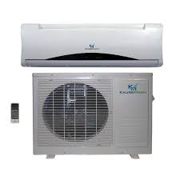
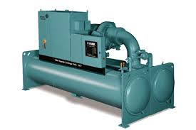
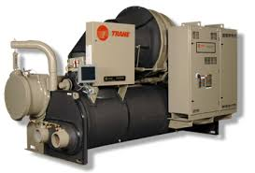
Pre Delivery
Verify performance of major equipment against specification or regulation where on site performance verification is not feasible.
Major equipment include Chillers and Switchboard
Switchboard Factory Test
Chiller Factory Performance Test
Notes:
- No no split unit---
- Now two mandatory equipment for air cond..
- must be tested but not necessary witnessed by us. Follow procedure.

Slide 10
Chiller Factory Performance Test
1
To verify published chiller capacity at rated or design condition.
2
To verify full load or part load performance at rated or design conditions.
In accordance with relevant standard e.g AHRI 550/590 or MS 2449
Notes:
Two parameters need to be tested. i.e capacity and energy performance

Slide 11
Chiller Factory Performance Test
 | SCHEDULE OF TECHNICAL DATA
ITEM | DESCRIPTION | SPECIFICATION | AIR COOLED CHILLER-1
A | AIR COOLED CHILLER | -
1 | MANUFACTURER | - | -
2 | COUNTRY OF ORIGIN | - | -
3 | TYPE/ MODEL | - | RECIPROCATING
4 | REFRIGERANT | R134a/ZERO ODP | R-407C
5 | RATED CAPACITY AT SPECIFIED CONDITIONS (TR)-AHRI | 180 | 190
6 | FULL LOAD KW/TR AT AHRI CONDITIONS | <1.4 | 1.38
 | IPLV (AHRI)
7 | KW/TR AT 75% LOAD & IPLV CONDITIONS | <1.3 | 0.93
8 | KW/TR AT 50% LOAD & IPLV CONDITIONS | <1.2 | 0.73
9 | KW/TR AT 25% LOAD & IPLV CONDITIONS | <1.5 | 0.83
10 | IPLV (AHRI) | <0.96 | 0.91
How to verify published data?

Slide 12
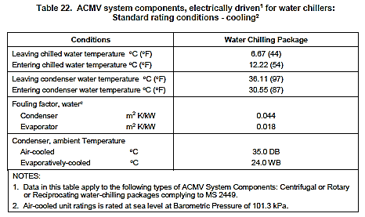
Chiller Factory Performance Test
Require testing at rated conditions
Field testing at rated conditions is nearly impossible task
Notes:
Full load performance test of chillers at actual condition is impossible.
There are cases where chiller when tested at low peak condition is already near full capacity.
Imagine what would be the result at peak conditions.
At this moment we haven't come out with acceptance criteria for chiller operational capacity limit.

Slide 13
Switchboard Test
Category | Current Rating | Registration and type of test report
I | I ≤ 600 A | Suruhanjaya Tenaga
II | 600 A ≤ I ≤ 1200 A | Suruhanjaya Tenaga & Partial Type Test in accordance with MS IEC 60439-1 (i) Short Circuit Test (ii) Temperature Rise Test
III | I ≥ 1200 A | Suruhanjaya Tenaga & Full Type Test in accordance with MS IEC 60439-1
Routine tests on the switchboard shall be carried out before delivery to site.
Test Results or Certificate duly certified by Competent Person as in Electricity Regulations 1994 shall be issued for every switchboard supplied and installed.

Slide 14
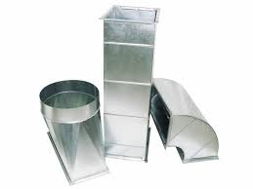
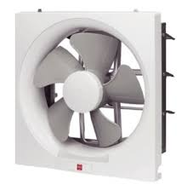
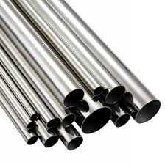
Delivery
Verify that delivered materials are as per approved materials and good physical conditions. Materials delivered to site shall be free from defects and adequately protected against harsh site conditions.
Notes:
- Forensic and Testing commissioining unit will come up with detail equipment delivery checklist
- Will be included under soon will be published Manual Pemeriksaan, pengujian dan pentauliahan

Slide 15
Installation
To verify that the installation works are carried out in accordance with specification and good engineering practises.
Cable Continuity Test
Hydrostatic Pressure Test
Duct Flushing
Pipe Flushing and Water Quality Test
Only for above 750 Pa (3.0 in wg) only
Support and Hanger Load Test
Duct Leak Test
LV Motors, Switch Gears and Cabling Insulation Test
Pipe Gradient Test
Notes:
Some of the test is already in current spec,
New improved procedures include duct and pipe flushing, duct leak test, condensate pipe gradient test and support and hanger load test

Slide 16
Installation
Test name | System/Component | Objectives
Hydrostatic Pressure Test | Chilled and condenser water pipe | Verify integrity of all pipe joints and fittings.
Pipe Flushing and Water Quality Test | Chilled and condenser water pipe | Verify that all pipes are internally clean and water quality are acceptable.
Support and Hanger Load Test | Equipment, piping, ductwork, etc. | Verify pipe support and hangers ability to withstand static load.
Duct Leak Test | Ductwork | Verify integrity of all duct joints and fittings.
Duct Flushing | Ductwork | Ensure that duct internal surfaces are free from dusk or foreign objects.
LV Motors, Switch Gears and Cabling Insulation Test | LV Motors, Switch Gears and Cabling | Verify insulation effectiveness.
Cable Continuity Test | Electrical Cabling | Verify cable continuity effectiveness.
Pipe Gradient Test | Condensate drain pipe | Verify condensate drain pipe gradient as per specification.

Slide 17
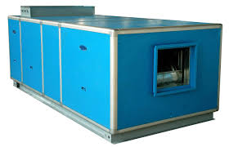
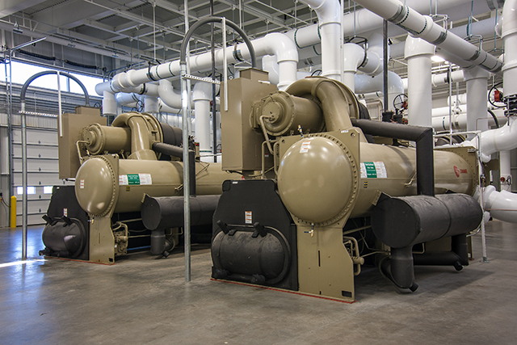
Functional Performance
To verify that the performance in terms of functionality, safety, maintainability and operation ability of the installed equipment/systems meet the specified design intent through a series of tests and adjustments.
Notes:
Chiller performance data may be verified via factory performance test.
System performance verification must be conducted on site.

Slide 18
Pre Functional Performance
Air Balancing
Ensure proper distribution of supply air as per load or design – 10% flow tolerance
Water Balancing
Ensure proper distribution of chilled/condenser water as per load or design – 10% flow tolerance
Accuracy Test
Ensure measurements accuracy prior to functional performance test
Notes:
New procedure included Accuracy test.
No point of testing using non calibrated meters.

Slide 19
Functional Performance
7 functional performance test series,
28 no of test
1
Chiller Plant
11 tests
2
Air Handling Unit and Fan Coil Unit
5 tests
3
Switchboard and Power Supply
3 tests
4
Air Distribution
3 tests
5
Infiltration
1 tests
6
Wall Insulation and Sprayed PU Foam Insulation Effectiveness
1 tests
7
Mechanical Ventilation
4 tests
Notes:
Detail in the spec.

Slide 20
Commissioning
Process of achieving, verifying, and documenting that the performance of facilities, systems, and assemblies meets defined objectives and criteria.
1
Handing Over Documents
- Test Report complete with fully verified Inspection checklist and Test Forms.
- Air Balancing and Water Balancing Report.
- Defects List
- Operation and Maintenance Manual which includes
- As-Built drawings
- Schedule of System Familiarization Program to end users.
2
System Familiarization Program
- Overview of design concept and objectives
- Operation instruction & competency requirement
Maintenance procedures
- Critical operating parameters monitoring and
- Emergency response & safety procedures.
- Environmental protection procedures.

Slide 21
Post Occupancy Evaluation
A survey carried out to evaluate user experiences with the air conditioning and ventilation system from comfort, operation ability or any other related problems. Data will be used for continues improvement.
Block
Floor
Space
AHU/FCU no
Indoor Air Conditions
Parameters | Measured value |  | Comment
Dry Bulb Temperature |  | ºC
Relative Humidity |  | %
User Survey
Any difficulty in operating the system? If Yes, please state the details.
Any specific problem system? If Yes, please state the details.
Notes:
Feed back control system
We are lack of this.
Sometime the T&C report is not relayed back to the designer. Not all project.

Slide 22
Conclusion
This new testing, adjustment, balancing and commissioning (TABC) enhanced specification will contribute to comprehensive system performance verification.
Only covers mechanical system, other building systems and architectural design that affect our system performance. e.g space layout, major openings shall also be looked into.
Series of training to familiarize CKM designers and construction supervisory teams will be conducted in the near future.
Any feedback for future improvement are most welcome.
Thank You
Notes:
This are not the perfect test specification. Any feedbacks are most welcome.
TQ

